Slide 1
AI Hackathon Attention is all what you need
Ahmed Dawoud
23/04/2025

Slide 2
Outline
Natural Language Processing (NLP)
The rise of transformer architecture
Generalization and transfer learning
AI frameworks for developers
Notes:
I will cover the Importance of Natural Language Processing (NLP) in driving AI forward.
And Key challenges in understanding and processing human language.
Next, I will provide an Introduction about the Transformer architecture.
Next, we will highlight methods of Transfer Learning
Finally, we will go through some of the commonly used AI Frameworks for developers in the biology domain

Slide 3
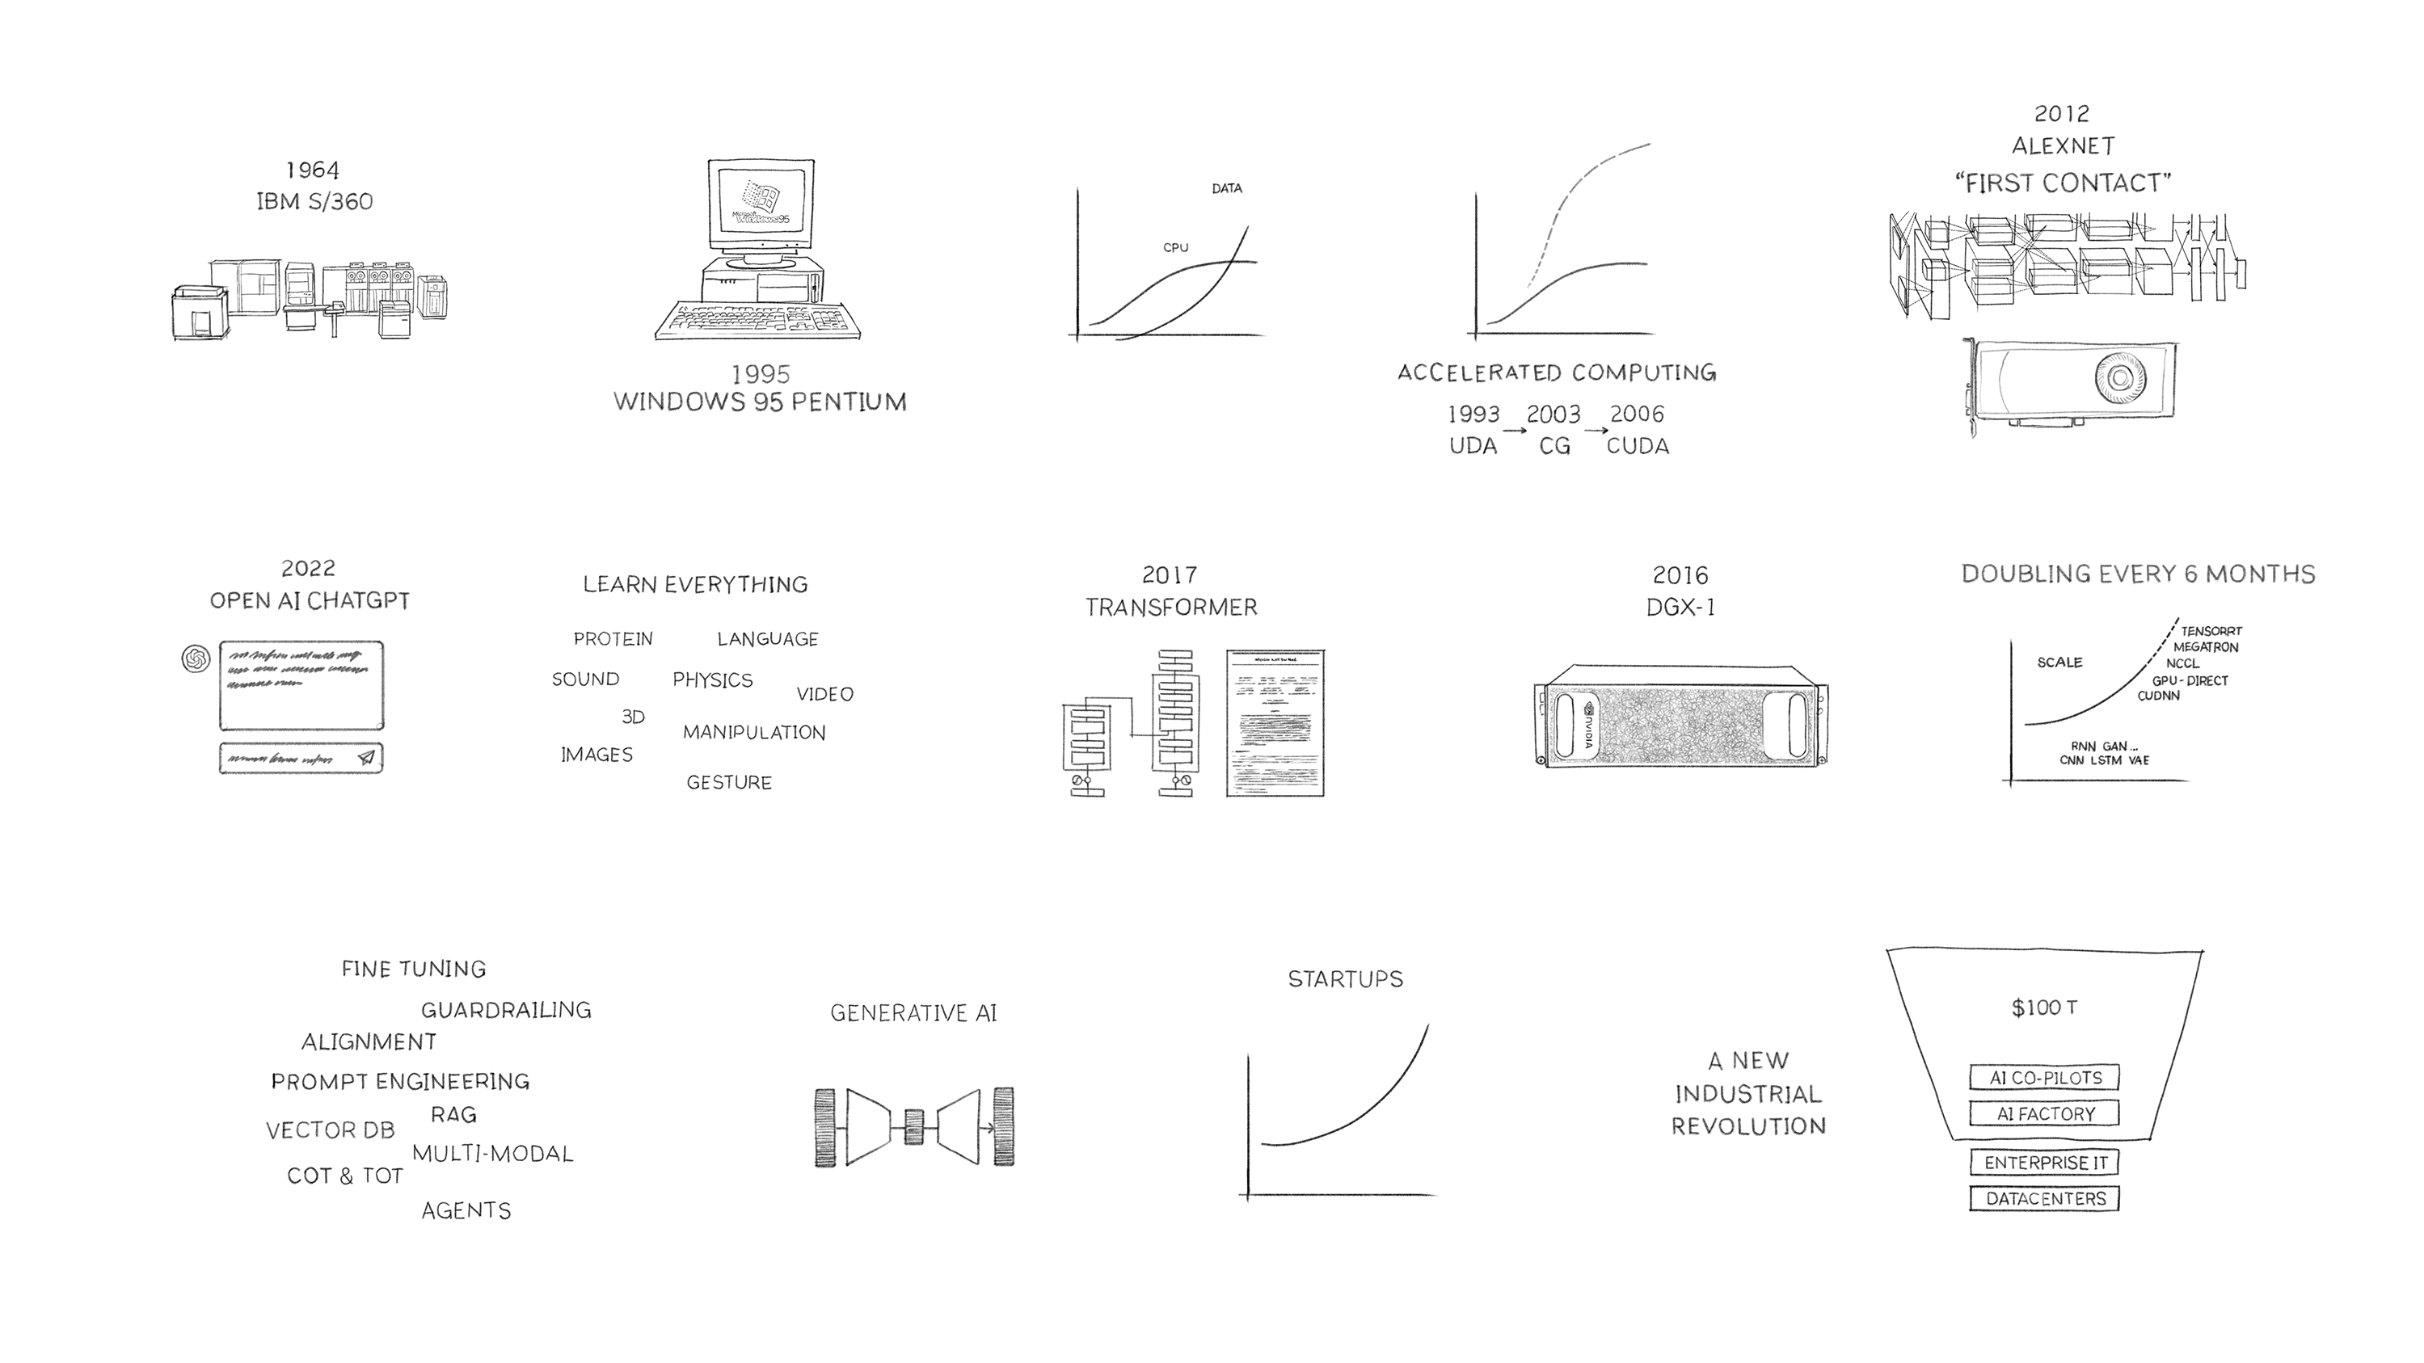
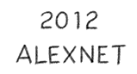
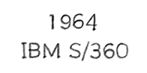
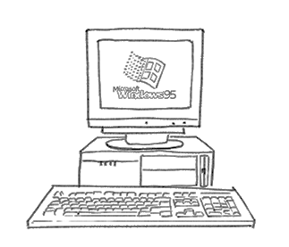
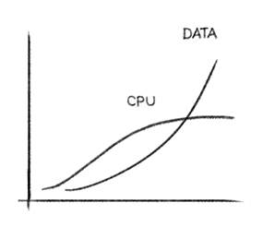
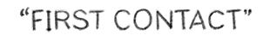
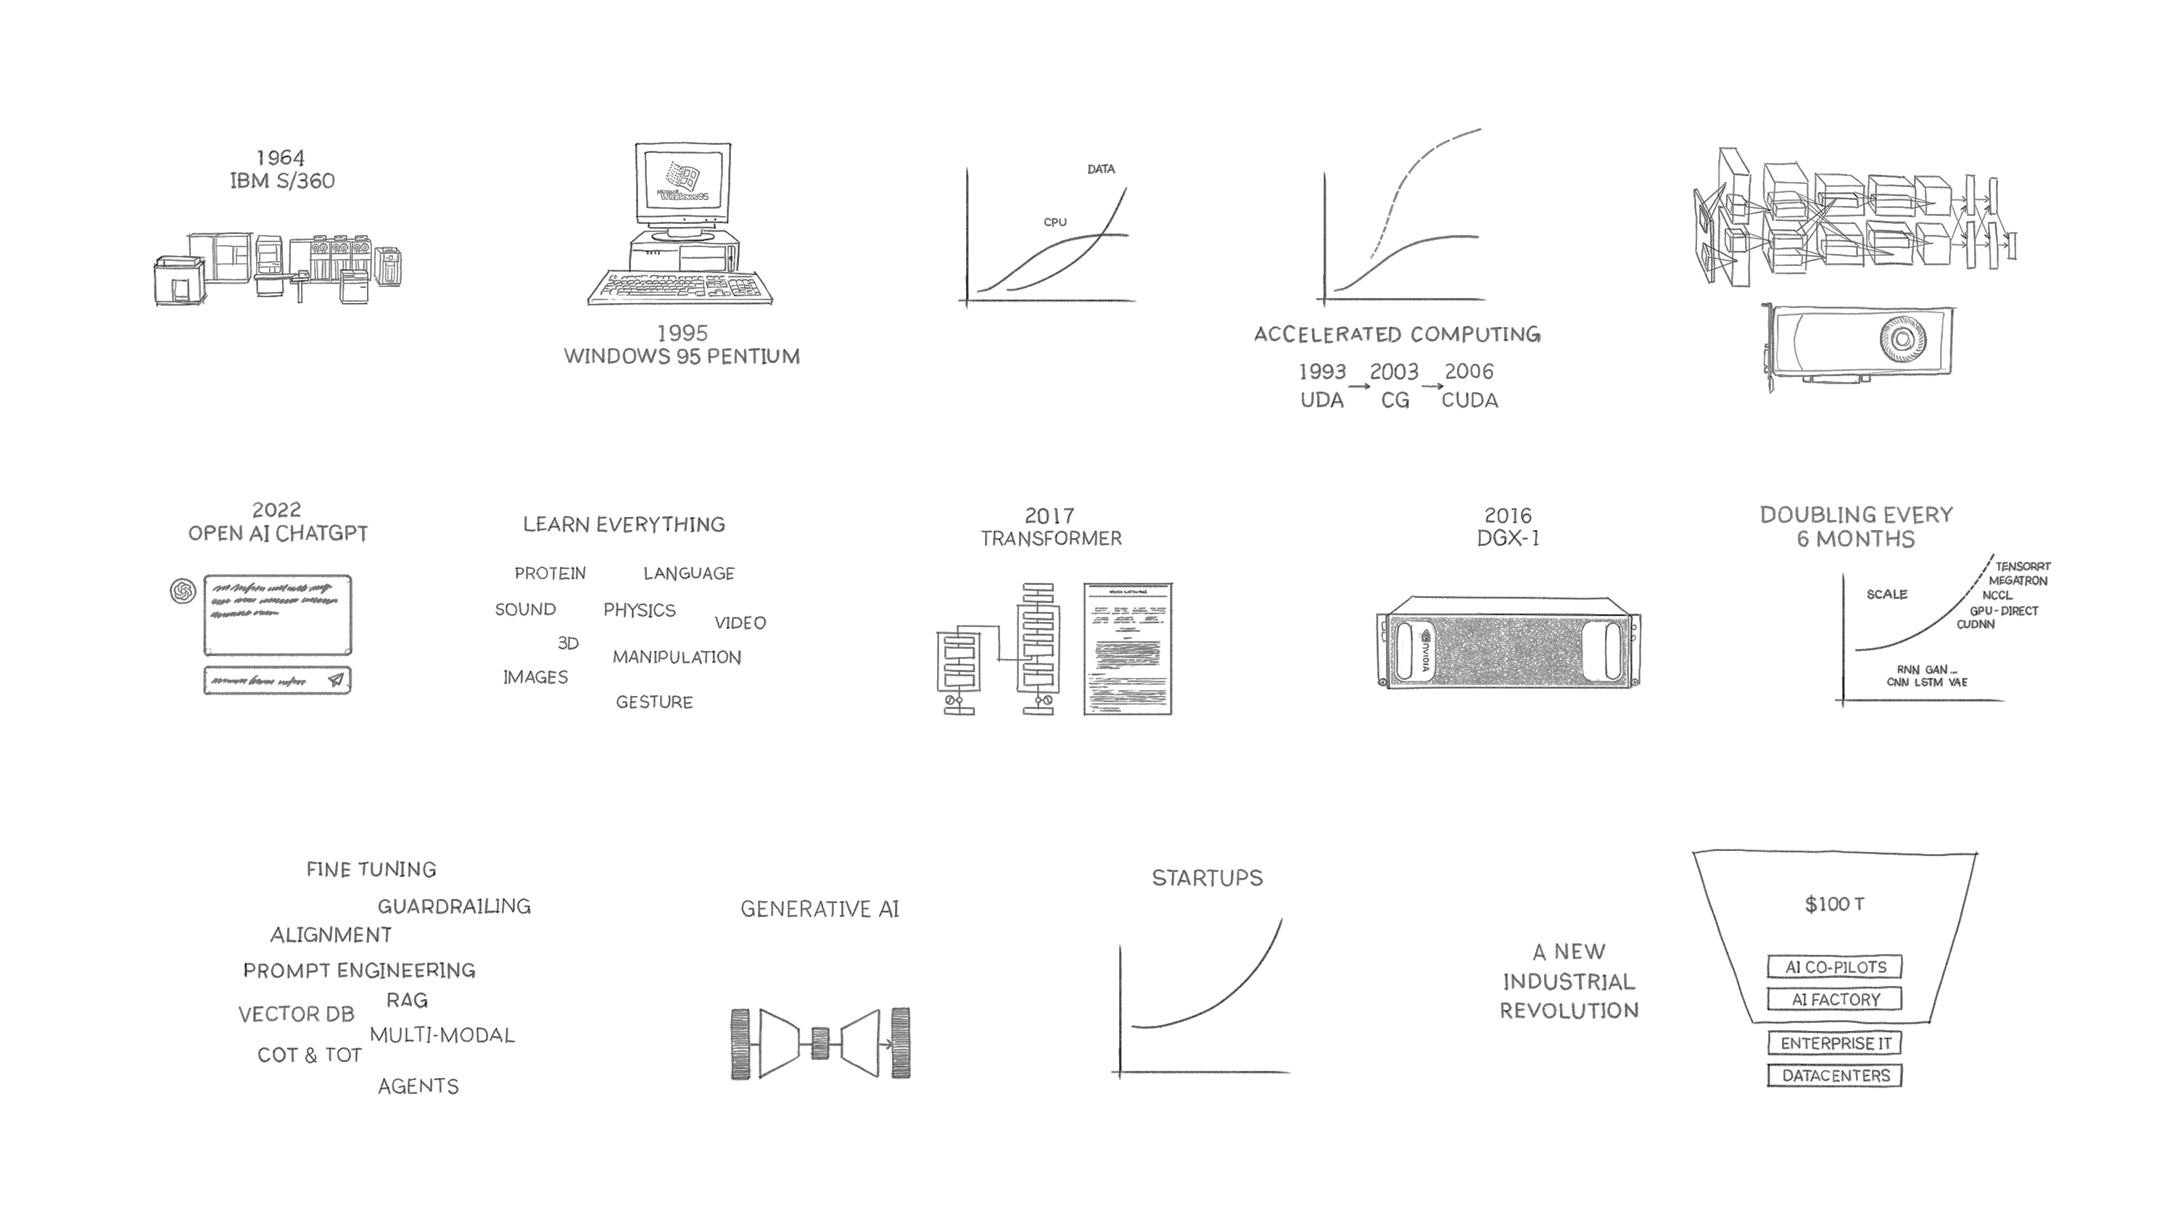
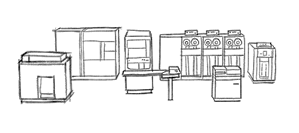
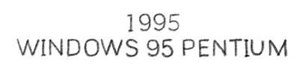
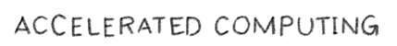
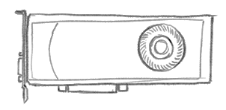
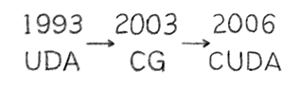
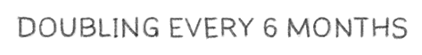
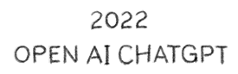
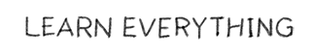
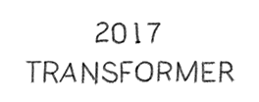
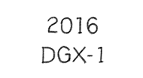
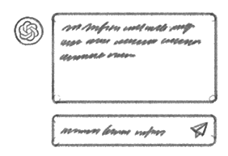
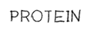
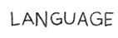
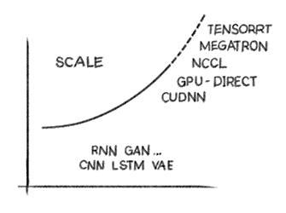
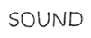
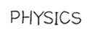
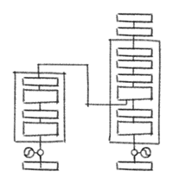
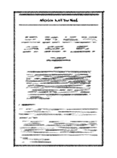
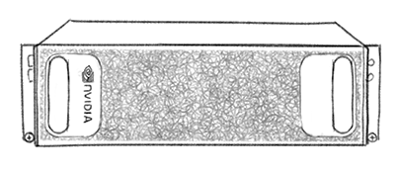
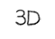
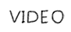

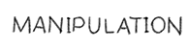
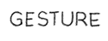
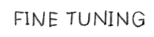

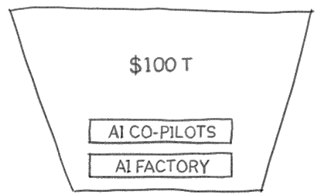
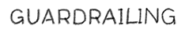
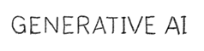
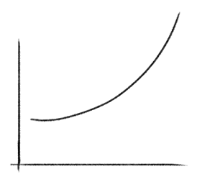
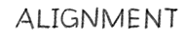
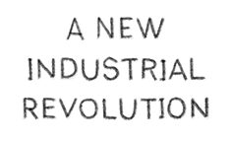
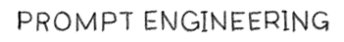
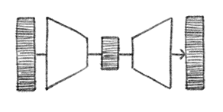
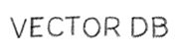
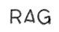
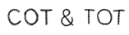
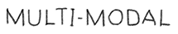
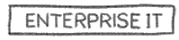
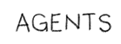
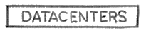
A New Industry Emerges
Notes:
The field of AI has rapidly grown from the 1960s until now. From early computing mainframes in the 60s to the personal computing era in the 90s. But, The real acceleration began with accelerated computing (The use of specialized hardware faster than the traditional CPUs, like GPUs and FPGAs. Many pivotal moments comes to the field, such as ,
2012 with AlexNet, showcasing the power of deep learning.
Developing specialized hardware for AI, like Nvidia hardware with multiple GPUs
One of the Key innovations like the Transformer architecture in 2017
It paved the way for the generative AI we see today, exemplified by OpenAI's ChatGPT. This isn't just about smarter software; it's the birth of a massive new industry,

Slide 4



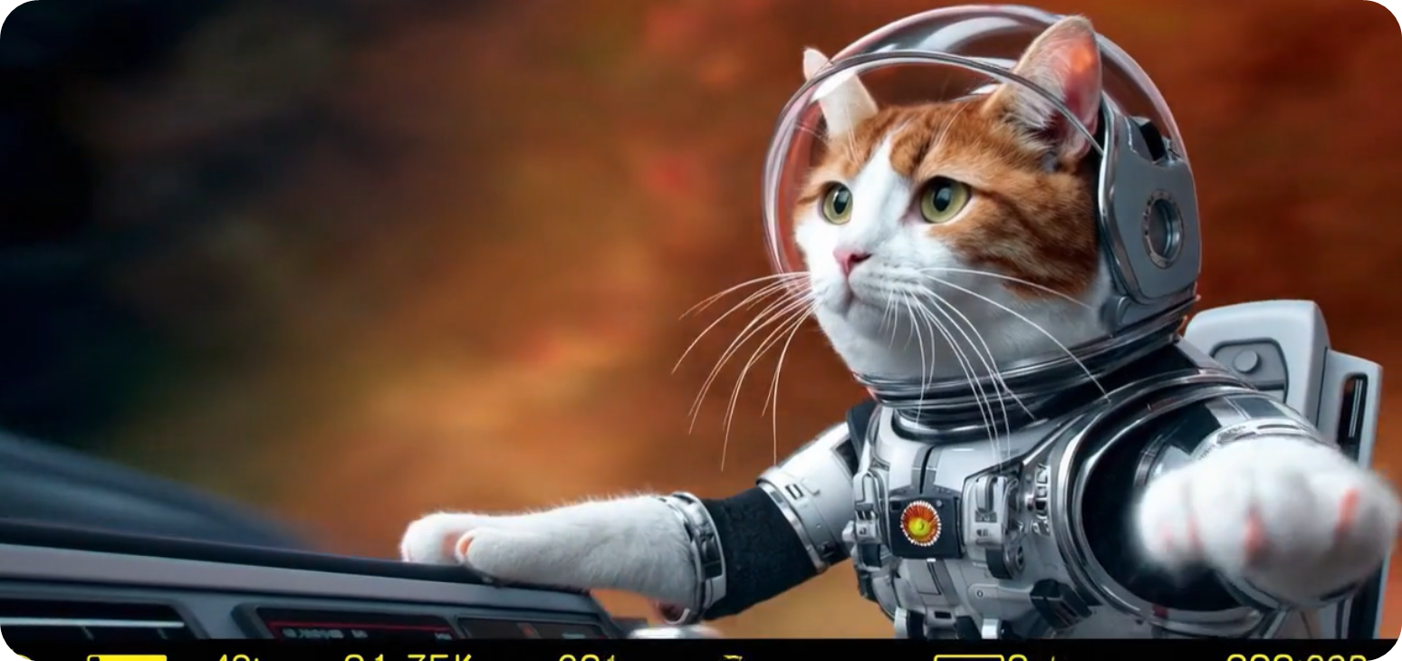


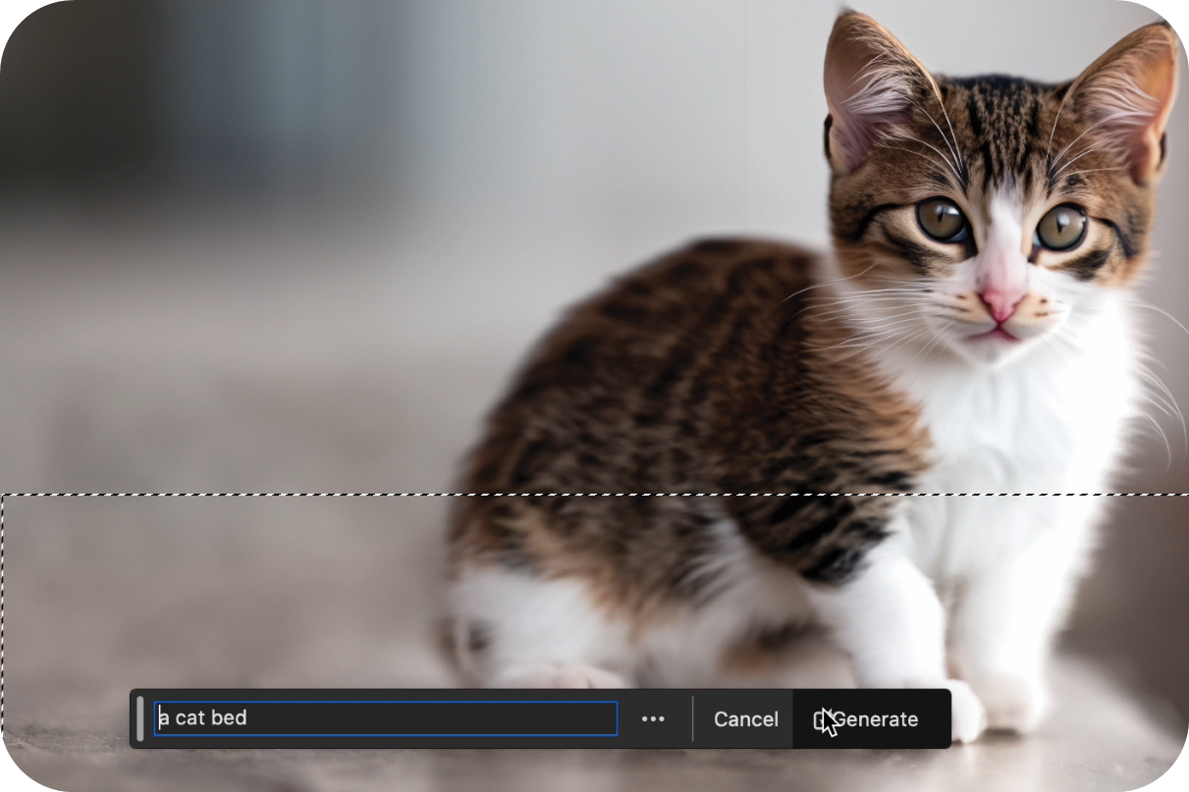

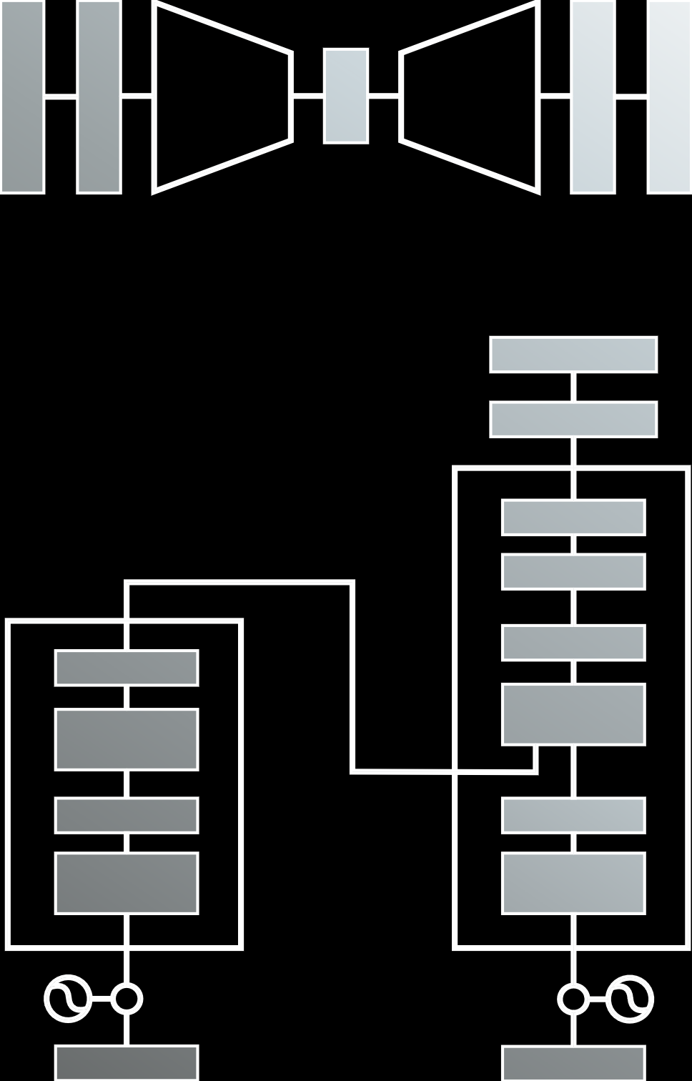
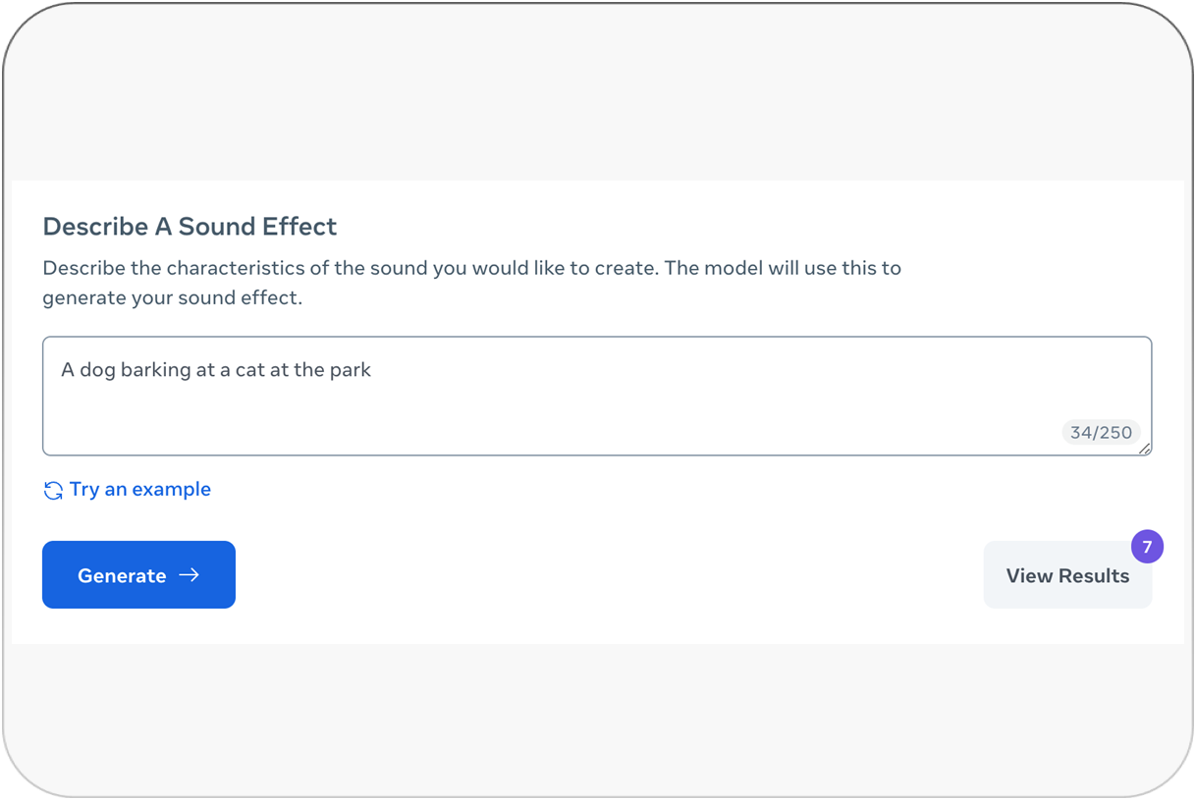









Sequence Modeling
Core Component of Generative AI
TEXT
IMAGE
LEARN AND UNDERSTAND
EVERYTHING
TEXT
VIDEO
IMAGE
IMAGE
VIDEO
3D
TEXT
SOUND
SPEECH
ANIMATION
MULTI-MODAL
MANIPULATION
AMINO ACID
PROTEIN
BRAINWAVES
SPEECH
Notes:
At the heart of Generative AI lies one powerful concept: sequence modeling. Whether we're generating text, code, images, music, or even simulating human conversations—what generative AI is really doing is understanding and predicting sequences.
Think of language. It’s just a sequence of words. Music? A sequence of notes. DNA? A sequence of bases. Everything we want a model to understand or generate can often be represented as a sequence.
Generative models like GPT, for example, are trained to predict the next token in a sequence—whether that token is a word, a pixel, a note, or a character in code. Over time, this enables the model to learn not just patterns, but deep structure and meaning in data.
So, when we talk about the power of generative AI, we're really talking about how well it can model sequences—to learn patterns, understand context, and create something new Language is not only a sequence of words. It has ambiguous structures. Language is full of grammar, sarcasm and metaphors. And It is hard to model

Slide 5
Automatic Writing
NLP TASKS
General Q&A
Intent Detection
Summary Generation
Common Sense Reasoning
Natural Language Processing
Word Sense
Auto Completion
Automatic Dialogue Generation
Translation
Sentiment Analysis
Code Generation
And many more….
Notes:
Language isn’t just a sequence of words — it’s rich, messy, and full of nuance. While it follows structure and grammar, it also includes: ambiguity, metaphors, sarcasm, and errors and typos
This makes human language hard to model, even though it’s sequential.
That’s where Natural Language Processing (NLP) comes in. NLP are a group of algorithms and models that can:
Handle the messiness of language
Understand context and meaning
Adapt to tone, style, and even cultural references
NLP tasks may include, ………….

Slide 6
Machine Learning
Discovering the discussed structures in text
Machine Learning Algorithm
Text
Notes:
ML is an aprobriate approach for language processing
What should we do next.
ML models expect a vector as input, not words, or paragraphs

Slide 7
Machine Learning
Discovering the discussed structures in text
?
Machine Learning Algorithm
Text
Notes:
As a consequence, what should be ML approach of choice

Slide 8
Machine Learning
Design decisions
?
Problem formulation
?
?
?
?
?
?
Machine Learning Algorithm
Text Pre-processing
Text Representation
Reweighting
Dimensionality Reduction
Vector Comparison
Text
Notes:
But actually the problem is larger, and have some small tasks.
Think about the process in the opposite way.
ML is expecting a vector.
ML has a capacity. You can not input all the data
Dimentionality reduction
Dimentionality reduction , requires reweighting of your data (normalization, or unified length)
Text representation into numerical format
Text preprocessing

Slide 9
THE Approach to NLP
Unsupervised feature representation + Machine Learning models
Subset of Problem formulations
Machine Learning Algorithm
Text Pre-processing
Text Representation
Reweighting
Dimensionality Reduction
Vector Comparison
Text
Subset of
approaches
Subset of word representations
Notes:
NLP systems typically learn feature representations from text in an unsupervised way,
and then use those features in a supervised machine learning model for specific tasks.

Slide 10
Transformers

Slide 11
Recurrent Neural Networks
Basic principles
y
y_{t-1}
y_{t}
y_{t+1}
y_{t+2}
s
s_{t-1}
s_{t}
s_{t+1}
s_{t+2}
x
x_{t-1}
x_{t}
x_{t+1}
x_{t+2}
Unrolling in Time
Notes:
Recurrent Neural Networks (RNNs) are a type of artificial neural network designed to work with sequential data. Here's an intuitive explanation of how RNNs work:
Its neorons has a memory. In other words, the output of the each neuron from the 1st step is fed-back to the neuron in the next setp
In essence, you can think of an RNN as a network that reads a sequence and maintains a "summary" of what it has seen so far. This summary (the hidden state) is updated with each new input, allowing the network to consider both the current input and the context from previous inputs when making predictions or generating outputs.
Memory of past inputs: Unlike traditional neural networks, RNNs have a "memory" that allows them to consider information from previous inputs when processing the current input. This makes them well-suited for tasks involving sequences, like text or time series data.
Limitations: Basic RNNs can struggle with long-term dependencies due to the vanishing gradient problem. This led to the development of more advanced architectures like LSTMs and GRUs.

Slide 12

Transformer is all about (Self) Attention
Notes:
Each word turns into a set of numbers (vectors).
It compares itself to all other words.
It gives more weight to important words and less weight to others.
Then it combines the information into a new, smarter version of the word.
Simply, you process all words in one go with less consumption for memory.
Ah, this image beautifully illustrates the connections within a classic self-attention mechanism! Let's break it down step by step.
Imagine you have a sequence of input tokens, perhaps words in a sentence. The bottom layer, labeled "embedding" and containing blocks with the number '0', represents the initial embeddings of these tokens. Each block corresponds to a token, and the vectors (h_1, h_2, \ldots, h_T) visually hint at the vector representations of these embeddings.
Now, the magic of self-attention happens when each token gets to "attend" to all other tokens (including itself) in the sequence to figure out which parts are most relevant for understanding its own meaning in the current context.
The middle layer, also labeled "attention" and containing blocks with the number '1', represents an intermediate stage. Notice how each block in this middle layer receives connections (the thin black lines) from all the embedding vectors in the layer below. This signifies that each token's representation at this stage is influenced by every other token's embedding.
The top layer, again labeled "attention" and containing blocks with the number '2', shows the final attention-weighted representation for each token. Observe how each block in this top layer receives connections from all the intermediate attention representations in the layer below. The varying thickness or number of lines (though they look uniform in this particular simplified diagram) would ideally represent the attention weights. A stronger connection (thicker line or more lines) would indicate that the token in the lower layer has a higher "attention score" and thus contributes more to the representation of the token in the upper layer.

Slide 13

Transformer architecture
Vaswani A, et, al. Attention is all you need. Advances in neural information processing systems. 2017;30.
Notes:
The original transformer architecture that was presented in 2017 has the following components
Let’s go through 2017 paper attention is all you need and its components
The paper showed a less complex model in comparison to CNN and RNN.
1- Tokenizer transforms the original text into initial numerical representation of the text composed of tokens (sub word components)
2- The tokenized text is then processed by the embedding mechanism. Embeddings are produced by an algorithm that transforms the original data into a numerical representation that can be consumed by the neural network. That numerical representation is frequently referred to as a textual embedding. (Vocabulary size x d_model)
3- positional encodings (PEs) are used to account for the order of the words in the input sequence.

Slide 14
Transformer architecture
Tokenizer
Tokenizer transforms the original text into initial numerical representation of the text composed of tokens (sub word components)
[Hello, World, ….., ….,….. ]
[7592, 2088, …..]
[batch_size, seq_len]
[25k, 512]
Dataset size = 2 x 4.5 million Sentences (WMT 2014 English – German)
Vocabulary size = 37,000
Maximum sequence length (seq_len) = 512 tokens
Batch_size = 25,000 tokens pairs
Notes:
Tokenizer transforms the original text into initial numerical representation of the text composed of tokens (sub word components)
Each model has some hyperparameters

Slide 15
Transformer architecture
Embedding (textual embedding)
The tokenized text is processed by the embedding mechanism.
Embeddings are produced by an algorithm that transforms the original data into a numerical representation that can be consumed by the neural network.
[Batch size , seq_len, d_model]
[25k, 512, 512]
Model dimension (d_model) = 512
(each token (subword is represented by a vector of 512 values)
Notes:
The tokenized text is then processed by the embedding mechanism. Embeddings are produced by an algorithm that transforms the original data into a numerical representation that can be consumed by the neural network. That numerical representation is frequently referred to as a textual embedding. (Vocabulary size x d_model)

Slide 16
Transformer architecture
positional encodings:
It is used to account for the order of the words in the input sequence
[1, sequence_length, d_model]
[1, 512, 512]
Embedding =
textual embedding + positional embeding
Notes:
But the textual embedding did not reflect the position of each

Slide 17

Transformers for Sequence Reasonings
Ordered Sequence of Classes
Attention
An attention mechanism looks at an input sequence and decides, at each step, which other parts of the sequence are important.
Attention in deep learning can be interpreted as a vector of importance weights.
[Batch size , seq_len, 3, n_head, d_head]
[25k, 512,512, 3, 8, 64]
Multi-head attention layer (n_head) = 8 heads
Dimensions per head (d_head) = (512 / 8 = 64 per head).
Query, Key and the Value.
Each have an associated weight matrix, which is trained through the optimization process.
Attention = a vector of importance weights.
Notes:
To reason with ordered SEQUENCES of classes:
From your input embeddings, derive 3 matrices, each being per-entry.
Use the key and value to compute attention (more details in notebook)
Lightweight interface produces a square matrix; self-attention
Feed the sequence-level logic back into the per-token pathway by multiplying with softmax-ed attention.
These components are known as transformer encoder blocks, and they generate per-token encodings with sequence-level knowledge

Slide 18
Transformer architecture
Encoder:
purpose is to encode a source sentence into hidden state vectors
Decoder
uses the last representation of the state vectors to predict characters in the target language
Autoregressive
Decoder:
generates one word at a time, from left to right. It attends not only to the other previously generated words, but also to the final representations generated by the encoder.
Masked Multi-Head Attention
Encoder= 6 layers
Decoder = 6 layers
Multi-head attention layer = 8 heads
Notes:
Tokenizer transforms the original text into initial numerical representation of the text composed of tokens (sub word components)
The tokenized text is then processed by the embedding mechanism. Embeddings are produced by an algorithm that transforms the original data into a numerical representation that can be consumed by the neural network. That numerical representation is frequently referred to as a textual embedding. (Vocabulary size x d_model)

Slide 19

Bidirectional Encoder Representations from Transformers (BERT)
The model is based on the encoder part of Transformer model.
Input: two sentences separated by a special token [SEP], and is pretrained using two loss functions:
Masked-language model prediction
Next sentence prediction
Devlin J, et al Bert: Pre-training of deep bidirectional transformers for language understanding.
InProceedings of the 2019 conference of the North American chapter of the association for computational linguistics: human language technologies,
volume 1 (long and short papers) 2019 Jun (pp. 4171-4186).
Notes:
Transformer architecture became the base for building other models.
Masked Language Model: We mask a percentage of the input tokens at random (say 15%) and ask the neural network to predict the entire sentence
Next Sentence Prediction: We choose either two consecutive sentences from text, or two random sentences from the text. We ask the neural network to establish whether the two sentences occur one after another.
We use another simpler neural network to replace random words in the sequence and ask the primary neural network to detect which words were replaced (using a GAN like configuration).

Slide 20

Generative Pretraining (GPT)
The design
Transformer Decoder
Predict next token
Self-Supervised
Training
Radford, A., et al. I. (2018). Improving language understanding by generative pre-training.

Slide 21
Transfer learning
Notes:
Transfer learning allowing us to build systems that adapt and perform well across a variety of tasks with minimal retrainingg is

Slide 22





FINE TUNING
Full Parameter Fine-Tuning
Copy to
Initial pre-trained LLM
Full parameter fine-tuning re-trains a LLM with a prompt dataset in a supervised manner, requiring an update of all model weights per task
Prompt dataset needs to be sufficiently large, on the order of thousands to hundreds of thousands of prompts
Dataset
(Prompt-Sample Pairs)
Training
New LLM
Pretraining on large, diverse datasets (e.g., text, images) using self-supervised learning.
Fine-tuning on downstream tasks with task-specific data.
Notes:
So what is fine-tuning? So far I've been throwing around this term "tuning" a lot and just kind of implicitly equating it with model customization.
Let's formalize this. Fine-tuning refers to a process for training deep learning models, where you start with a pretrained model's weights, and then update these weights by training on new data. You might be already familiar with this, because the concept isn't unique to LLMs, it's been around a long time.
Many of the foundation models you may be familiar with like ChatGPT have already gone through fine-tuning. They were first pre-trained on some unsupervised task like next token prediction, given a massive corpus of text. Then they went through a supervised fine-tuning stage, where they were given labeled training data, essentially lots of examples of input and output pairs.
Ultimately, what I want you to take away from this slide is with supervised fine-tuning, there are both heavy compute requirements (because we're training the full parameters of the model) and heavy data requirements (we need thousands, hundreds of thousands of rows of labeled data).

Slide 23

Zero/few shot approach (Prompt Engineering)
Prompt design is crucial to obtaining good results from an LLM
Zero-Shot Response
Few-Shot Response
Asking the foundation model to perform a task with no previous example or knowledge
Providing a couple examples as context to the foundation model before giving it a task
Q: What is the capital of Spain?
A: {'answer': 'Madrid'}
Q: What is the capital of Italy?
A: {'answer': 'Rome'}
Q: What is the capital of France?
Q:“What is the capital of France?”
A: {'answer': 'Paris'}
A: “Paris”
LLM
LLM
Lower token count
More space for context
Better aligned responses
Higher accuracy on complex questions
Notes:
--- Notes ---
Good location to demo NeMo Playground
That's prompt engineering.
With prompt engineering we're not training any model, updating any weights. We're just formatting our prompt with instructions on what to do, and potentially including a few examples of quote-unquote training data. That number of examples is typically on a single digit level.
Now there are some tradeoffs to prompt engineering. You're packing a lot of text into the prompt, which increases the token count. That's going to increase costs with an API-based LLM, and reduce the amount of space in your context window.

Slide 24
AI frameworks

Slide 25



AI frameworks in Biology
BioNemo
Helical
DeepChem
End-to-end platform for developing and using foundation models
Tools for interact with hardware (CPU, CUDA?)
Pretrained Biomolecular Models: Models tailored for tasks like protein structure prediction and molecular property estimation.​
Data Atlas: A comprehensive repository of biological datasets for training and benchmarking.
Data Loaders: Specialized tools for handling biological datasets.​
Training and Fine-tuning Tools: Support for large-scale training across multiple GPUs.​
Inference Microservices (NIMs): Optimized services for deploying models in production environments.

Slide 26
Summary
Natural Language Processing (NLP) enables computers to human languages.
Transformers provides less complex architecture in-comparison to traditional Recurrent Neural Networks (RNNs)
Transformers enabled transfer learning methods,: pre-train on large amounts of data and fine-tuned for specific tasks with limited data.
AI Frameworks provides user-friendly tools for non-specialists.

